Slide 1
LG Boost Algorithm

Slide 2
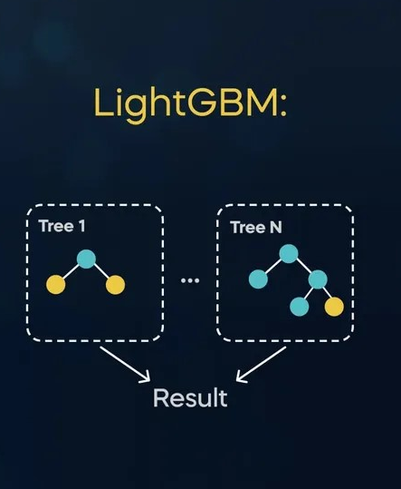
LG – Light Gradient Boosting Algorithm
LGBMRegressor is a machine learning model used to predict continuous (numeric) values using the LightGBM (Light Gradient Boosting Machine) framework. It implements gradient boosting, an ensemble method where several decision trees are built sequentially, with each new tree correcting the errors of the previous ones.
Used both in Regression & Classification based on the Target.

Slide 3
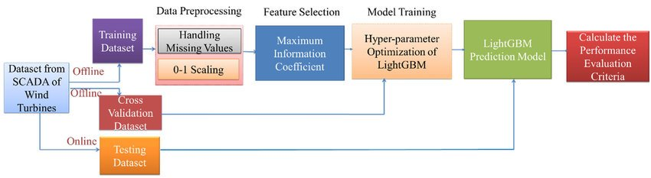
Work Flow Of LG BOOST (with Proved Example)
Data Input: Feed the training data to the model (features and target values).
Tree Building: The model constructs multiple decision trees, each trying to improve on the errors of the previous trees.
Prediction: Once trained, the model uses these trees to predict the numeric output for new, unseen data.

Slide 4
Why Use LGBMRegressor?
Fast Training: Efficient for large datasets.
Scalable: Works well with large feature sets and lots of data.
Accurate: Gradient boosting is one of the best-performing algorithms in machine learning.
Customizable: Many hyperparameters to tune for better performance (e.g., number of trees, learning rate, max depth, etc.).

Slide 5
Tips :Using LightGBM Algorithm Effectively
Parameter Tuning
Festure Selection
Early Stoping
Overfit Prevention

Slide 6
Applications in Real Life
Finance: Stock price prediction, credit scoring, sales forecasting.
Retail: Demand forecasting, price optimization, customer lifetime value prediction.
Healthcare: Disease risk prediction, healthcare cost estimation, treatment effectiveness.
Real Estate: House price prediction, property valuation, rental price estimation.
Energy: Energy consumption forecasting, renewable energy output prediction.
Transportation: Ride-sharing demand, delivery time estimation, route optimization.
Manufacturing: Predictive maintenance, production optimization, quality control.
Environment: Weather forecasting, pollution level estimation.
Marketing: Customer churn prediction, conversion rate prediction, ad click-through rate.
Automotive: Vehicle price prediction, fuel efficiency estimation, autonomous vehicle performance.

